Slide 1
Course Title - DevOps
Topic Title - DevOps Tools and Technologies
Understanding the difference between virtual machines and containers
Presenter’s Name - M ArunKumar
Presenter’s ID - IARE11151
Department Name - CSE (AI & ML)
Lecture Number - #
Presentation Date - 04/03/2025

Slide 2
Understanding the difference between virtual machines and containers
Overview of Docker Containers
Docker containers are lightweight, portable, and self-sufficient units that encapsulate an application and its dependencies. They allow you to run applications in isolated environments, ensuring consistency across different environments (development, testing, production, etc.). Containers share the same host OS kernel but run in isolated processes, making them more efficient than traditional virtual machines.
1. What Are Docker Containers?
Docker containers are a way to package an application along with its dependencies, libraries, and other necessary configurations into a single unit that can run anywhere. A Docker container includes:
The application code (e.g., a web app or a database server)
System tools (such as command-line tools required by the application)
Libraries (e.g., specific versions of Python, Node.js, etc.)
Settings/configuration files (environment variables, etc.)
How Containers Work
Isolation: Containers isolate the application from the host system and other containers, ensuring that any changes made within a container do not affect other parts of the system.
Efficiency: Containers use the host OS kernel and run as isolated processes, making them more resource-efficient than traditional virtual machines (VMs), which require separate operating systems for each instance.
Portability: A container can run consistently across different environments (local machine, development server, cloud, etc.) as it contains everything needed for the application to work.

Slide 3
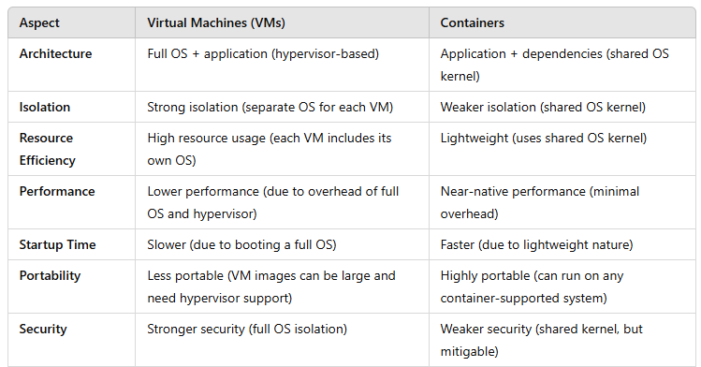
Understanding the difference between virtual machines and containers
Here's a comparison of Virtual Machines and Containers

Slide 4
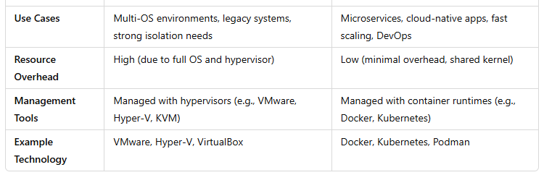
Understanding the difference between virtual machines and containers
Summary:
VMs are like running an entire computer inside another computer with its own OS and full resource allocation.
Containers are like running isolated applications within the same OS, sharing the kernel for efficiency.

Slide 5
Thank You

